Slide 1
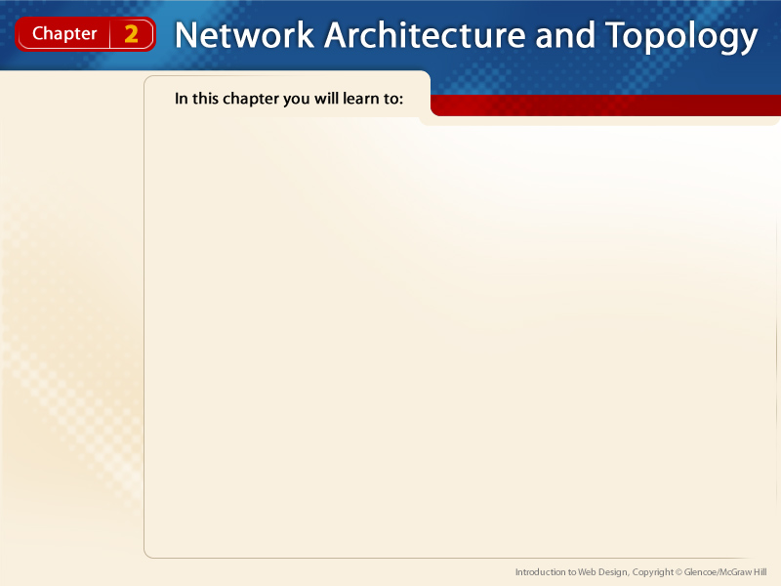
Section 2.1
  Compare and contrast clients and servers
  Define dedicated and nondedicated servers
  Identify the tasks of dedicated servers
Section 2.2
  Compare and contrast types of networks
  Describe LANs and WANs
  Classify networks by configuration and geographic area

Slide 2
Section 2.3
  Determine appropriate networks
  Consider advantages and disadvantages of network architectures
Section 2.4
  Describe topologies
  Determine a topology for a network plan

Slide 3

Networking Components
pp. 36-41
2.1
Guide to Reading
Main Ideas
Networks consist of client and server computers. Servers can be dedicated or nondedicated servers.
Key Terms
client
thin client
server
nondedicated server
dedicated server
peripheral
media
data
Redundant Array of Inexpensive Disks (RAID)

Slide 4
Networking Components
pp. 36-41
2.1
The Parts of a Network
All networks are made up of the same basic components.
The most important of these are clients and servers.
client A network computer that requests, or orders, information from a server. (p. 36)
server Computers that work behind-the-scenes to provide (serve) shared resources to network users, or clients. (p. 36)

Slide 5
Networking Components
pp. 36-41
2.1
The Parts of a Network
Client computers are desktop machines with local storage and processing power.
A thin client is a network computer with no local storage. It processes information independently, but relies on servers for applications, data storage, and administration.
thin client A network computer that has no local storage and relies on servers for applications, data storage, and administration. (p. 36)

Slide 6
Networking Components
pp. 36-41
2.1
The Parts of a Network
Servers are categorized as either nondedicated servers or dedicated servers, depending on the type of work they do.
A nondedicated server can be used for everyday tasks such as e-mail or word processing.
A dedicated server functions only as a server. It is not used as a client or workstation. It is dedicated to one purpose—being a server.
nondedicated server A server that provides many different services to its client computers, such as file retrieval, printing, and e-mailing. (p. 37)
dedicated server A server that provides a specific type of resource to its clients, such as just printing. (p. 37)

Slide 7
Networking Components
pp. 36-41
2.1
The Parts of a Network
Networks, however, are not complete with just clients and servers. A typical network also includes peripherals, media, and data.
peripheral A device that is connected to a computer and is controlled by its microprocessor. (p. 38)
media Physical pieces of equipment used to transport data from one computer to another computer or peripheral device on the network. (p. 38)
data Distinct pieces of information, such as files or entries in a database. (p. 38)

Slide 8
Networking Components
pp. 36-41
2.1
Specialized Servers
There are different types of servers, particularly dedicated servers.
file servers
print servers
application servers
mail servers
communication servers
directory services servers
backup servers

Slide 9
Networking Components
pp. 36-41
2.1
Specialized Servers
Many backup servers use a technique called “mirroring” to protect data. Mirroring employs an array of hard drives, called Redundant Array of Inexpensive Disks (RAID).
Redundant Array of Inexpensive Disks (RAID) An array of hard drives that mirror or duplicate other drives. Should the primary hard drive fail, the second drive can be substituted for the failed drive with little or no down time. (p. 41)

Slide 10
Types of Networks
pp. 43-48
2.2
Guide to Reading
Main Ideas
Networks can be classified according to how servers and clients are configured, or put together. They can also be categorized by the geographic area they cover.
Key Terms
peer-to-peer network
client/server network
local area network (LAN)
wide area network (WAN)
node
wireless local area network (WLAN)
bandwidth

Slide 11
Types of Networks
pp. 43-48
2.2
Classifying Networks by Configuration
A network’s configuration describes how the types of servers and clients are used in the network.
Networks are generally divided into three broad categories based on their configuration: centralized networks, peer-to-peer networks, and client/server networks.
peer-to-peer network A network that does not require an administrator and whose computers function as both clients and servers. (p. 44)
client/server network A network built around one or more dedicated servers and is administered from a central location. It supports many clients and multiple computer platforms. (p. 45)

Slide 12
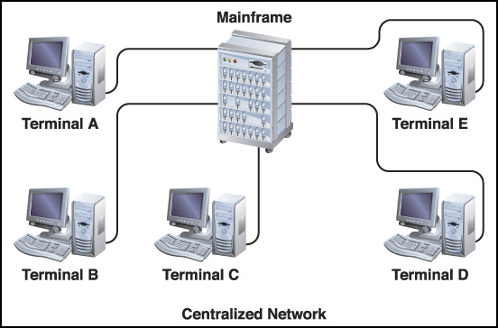
Types of Networks
pp. 43-48
2.2
Classifying Networks by Configuration
Centralized networks are built around mainframes and terminals.

Slide 13
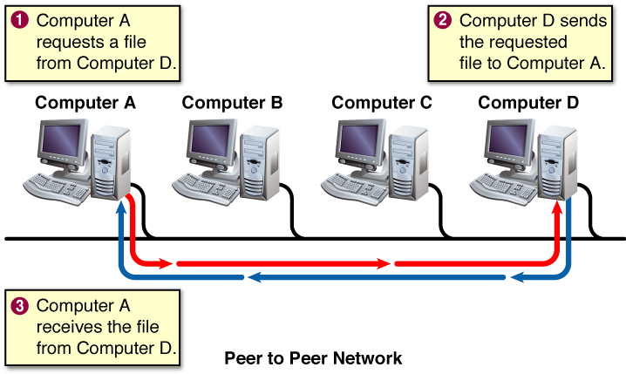
Types of Networks
pp. 43-48
2.2
Classifying Networks by Configuration
In a peer-to-peer network, computers function as both clients and servers.

Slide 14
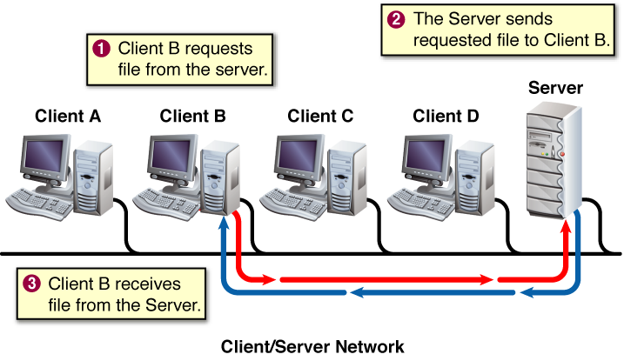
Types of Networks
pp. 43-48
2.2
Classifying Networks by Configuration
A client/server network is built around one or more dedicated servers. Clients connect to the dedicated servers through the network

Slide 15
Types of Networks
pp. 43-48
2.2
Classifying Networks by Geographic Area
The second main way to classify networks is to group them by how much geographic area they cover.
Networks that are relatively limited in size are called local area networks (LANs). Those that cover a larger area are called wide area networks (WANs).
local area network (LAN) A network that is relatively limited in size and that usually connects computers in a small geographical area, such as in the same office building. (p. 45)
wide area network (WAN) A computer network that uses long-range telecommunication links to connect networked computers across long distances. (p. 45)

Slide 16
Types of Networks
pp. 43-48
2.2
Classifying Networks by Geographic Area
A true peer-to-peer network is a LAN because it can support only a limited number of clients and peripherals, also known as nodes.
node Each piece of hardware, such as a server, client, and shared peripheral, that is connected to a network. (p. 45)

Slide 17
Types of Networks
pp. 43-48
2.2
Classifying Networks by Geographic Area
Some LANs make use of wireless technology to create wireless local area networks (WLANs). WLANs use media just like wired networks do, but you cannot see wireless media.
wireless local area network (WLAN) A local area network that uses either infrared (IR) light or radio frequencies (RF) to connect the clients and/or peripherals. (p. 46)

Slide 18
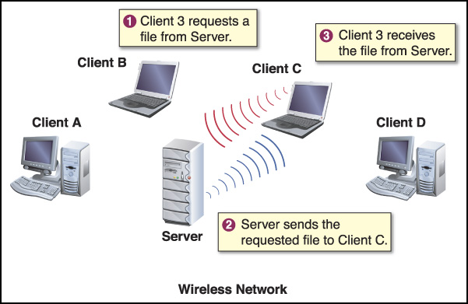
Types of Networks
pp. 43-48
2.2
Classifying Networks by Geographic Area
Wireless networks eliminate cabling between clients and servers.

Slide 19
Types of Networks
pp. 43-48
2.2
Classifying Networks by Geographic Area
Most WANs use media that can very quickly transfer large amounts of data. These media include wireless connections, satellite uplinks, or specialized types of cabling, such as T1/T3 telephone-type lines or fiber optic cables.
Using these media allows the WANs to employ a large amount of bandwidth.
bandwidth Amount of data that can be transmitted in a given amount of time. (p. 46)

Slide 20
Types of Networks
pp. 43-48
2.2
Classifying Networks by Geographic Area
Depending on the amount of ground they cover, WANs are often categorized in subgroups or smaller clusters. These WAN subgroups include:
campus area networks (CANs)
metropolitan area networks (MANs)
home area networks (HANs)
global area networks (GANs)
storage area networks (SANs)

Slide 21

Types of Networks
pp. 43-48
2.2
You Try It
Activity 2A - Identifying the Type of Network (p. 47)

Slide 22
Network Architecture
pp. 49-54
2.3
Guide to Reading
Main Ideas
Choosing the right network architecture requires careful planning. The network’s current and future needs must be balanced against the costs of implementing and maintaining the network. Each network architecture has advantages and disadvantages.
Key Terms
security
network interface card (NIC)
local user
remote user
network operating system (NOS)

Slide 23
Network Architecture
pp. 49-54
2.3
Choosing a Network Architecture
The type of network that is chosen depends on several factors, such as those in the following list.
type of user
size of the organization
administration
security
network traffic
cost
scalability
security The capability of the network operating system to secure data from unauthorized access. (p. 49)

Slide 24
Network Architecture
pp. 49-54
2.3
Peer-to-Peer Considerations
All of the computers on a peer-to-peer network can act as clients and respond as servers.
To communicate with one another, both client and server computers must be equipped with a network interface card (NIC).
network interface card (NIC) A hardware component that enables both client computers and servers to communicate with one another. Also known as network adapter card. (p. 50)

Slide 25
Network Architecture
pp. 49-54
2.3
Peer-to-Peer Considerations
On a peer-to-peer network:
All users can share any of their resources in any manner they choose.
Each computer uses a large percentage of its resources to support the local user.
Additional resources are needed, such as hard disk drive space and memory, to support the remote users.
local user The user at the computer. (p. 51)
remote user A user who dials in to the server over modems and telephone lines from a remote location. (p. 51)

Slide 26
Network Architecture
pp. 49-54
2.3
Peer-to-Peer Considerations
Advantages include:
ease of installation
no dedicated server or NOS
individual control of user resources
low cost
Disadvantages include:
the limitations in geographic area
scalability
difficulty in ensuring security

Slide 27
Network Architecture
pp. 49-54
2.3
Client/Server Considerations
One basic consideration for client/server networks is the size.
Client/server networks can support thousands of client computers.
The clients have their own local storage and processing power.
The client connects to the network to access the resources, such as printers, servers, and so on.

Slide 28
Network Architecture
pp. 49-54
2.3
Client/Server Considerations
The network operating system (NOS) used on a server in a client/server network must be much more robust than a peer-to-peer operating system. The NOS must quickly and effectively answer the demands of many users, and also provide administrative and security functions.
network operating system (NOS) An operating system designed to support networking. A network operating system must answer the demands of many users, and must do so quickly and effectively. (p. 52)

Slide 29
Network Architecture
pp. 49-54
2.3
Client/Server Considerations
NOS software includes Windows 2003 Server, Mac OS X Server, Unix, Linux, and Novell NetWare.
The NOS must also deliver:
fault tolerance
different levels of access
backup capability
centralized monitoring and administration
control of network traffic

Slide 30
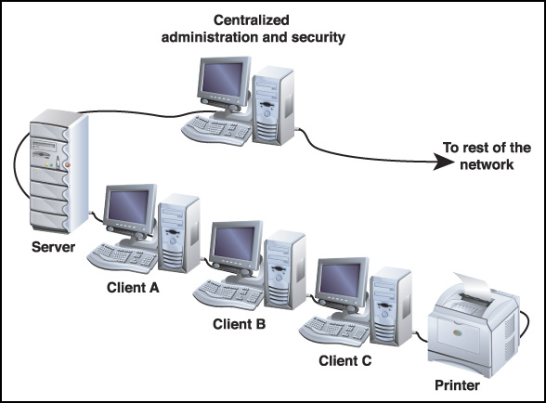
Network Architecture
pp. 49-54
2.3
Client/Server Considerations
A centralized security system uses firewalls, passwords, and other security systems to protect the network.

Slide 31
Network Architecture
pp. 49-54
2.3
Client/Server Considerations
Advantages of a client/server network are the following:
scalable and cost less than centralized networks
support many users
more powerful than peer-to-peer networks
centralize security and administration while controlling access to resources
communicate with other networks and support remote access, Internet sites, and multiple computing platforms

Slide 32
Network Architecture
pp. 49-54
2.3
Client/Server Considerations
The disadvantages of client/server networks are the following:
they are more expensive to implement
more complicated to administer than peer-to-peer networks
server failures can bring down the entire network

Slide 33
Network Architecture
pp. 49-54
2.3
Hybrid Networks
Hybrid networks utilize the capabilities of both peer-to-peer and client/server architectures. In a client/server network, the servers run a NOS, and the desktop computers run a client OS.
Because client OSs have built-in, peer-to-peer sharing capabilities, the desktop machines can make their own resources available to their peers without requiring support from their servers.

Slide 34
The Shape of a Network
pp. 56-62
2.4
Guide to Reading
Main Ideas
There are four basic network shapes, or topologies. When planning a network, the advantages and disadvantages of each type need to be evaluated to provide a solution that meets the needs of the network users.
Key Terms
topology
bus network
trunk
carrier sense multiple accesses with collision detection (CSMA/CD)
terminator
star network
hub
ring network
token
mesh network

Slide 35
The Shape of a Network
pp. 56-62
2.4
Network Topologies
The shape, or topology, of a network refers to the way the computers are cabled together. There are four basic designs that networks follow:
bus
ring
star
mesh
topology The design or layout of a network. Refers to the way the computers are connected. (p. 56)

Slide 36
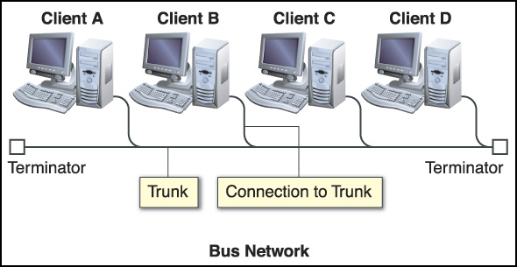
The Shape of a Network
pp. 56-62
2.4
Network Topologies
A bus network (or linear network) consists of a single cable, or trunk, to which the client computers and servers connect.
bus network A linear network based on a main trunk line. It is the simplest and easiest topology to implement. (p. 57)
trunk A single main cable in a bus network to which nodes, the client computers, and servers connect. (p. 57)

Slide 37
The Shape of a Network
pp. 56-62
2.4
Network Topologies
The Ethernet, the most well-known type of bus network, manages data collisions using a technique known as carrier sense multiple accesses with collision detection (CSMA/CD).
The end of every cable in a bus network must be equipped with a device called a terminator.
carrier sense multiple accesses with collision detection (CSMA/CD) The technique used to manage the problem of two nodes on a bus network that transmit data at the same time and the data run into each other. (p. 57)
terminator A device at the end of a cable that absorbs the signals and keeps them from bouncing back along the line or trunk. (p. 57)

Slide 38
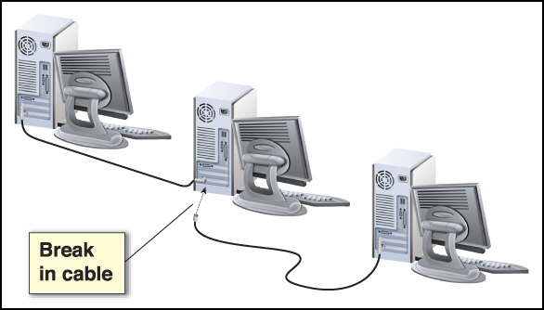
The Shape of a Network
pp. 56-62
2.4
Network Topologies
A break in the cable can occur if the following occurs:
the cable is physically separated into two pieces
at least one end of the cable becomes disconnected.
In either case, one
or both ends of the
cable are no
longer terminated,
causing the signal
to bounce.
The computers on
the network can still
function as stand-
alone computers. However, as long as the segment is broken, they cannot communicate with each other or access shared resources.

Slide 39
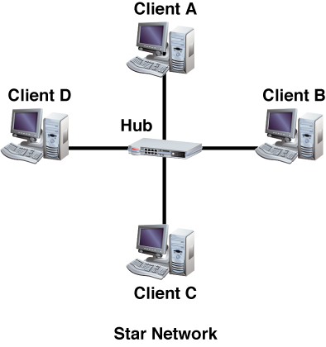
The Shape of a Network
pp. 56-62
2.4
Network Topologies
A star network stretches out in different directions from a central location. At the center of the star is a hardware device known as a hub.
star network A network that stretches out in different directions from a hub in a central location. (p. 58)
hub A hardware device that connects the nodes in the arms of a star network. A hub can be active—boosts the signal, or it can be passive—simply relay the signal. (p. 58)

Slide 40
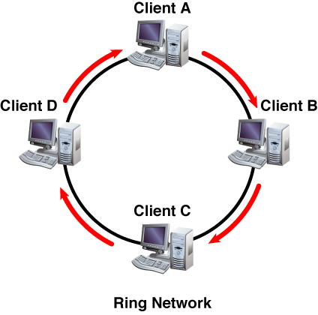
The Shape of a Network
pp. 56-62
2.4
Network Topologies
In a ring network, the nodes form a circle. Data are transmitted around the ring using token passing.
ring network A network topology that forms a circle, at least as far as the nodes are concerned. (p. 59)
token The small collection of bits computers pass in token passing. (p. 59)

Slide 41
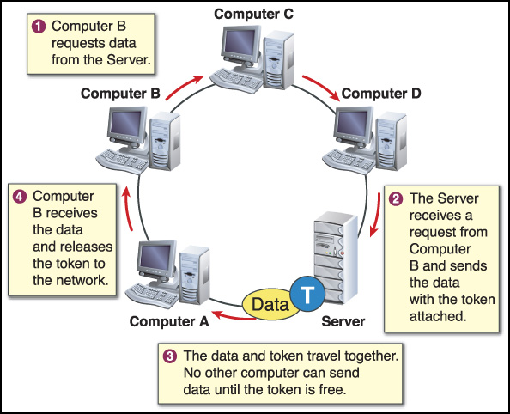
The Shape of a Network
pp. 56-62
2.4
Network Topologies
In token passing, a sending computer must have the token to send data. The sending computer passes the token and the data around the ring to the receiving computer.

Slide 42
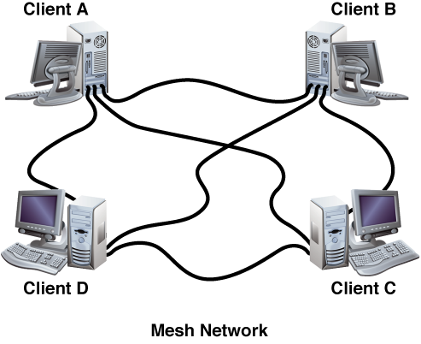
The Shape of a Network
pp. 56-62
2.4
Network Topologies
In a mesh network, each computer is connected to every other computer by separate cabling.
mesh network A network topology in which each computer is connected to every other computer by separate cabling. This topology provides redundant paths throughout the network. If one cable fails, another takes over the traffic. (p. 60)

Slide 43
The Shape of a Network
pp. 56-62
2.4
Network Topologies
Networks can also be designed as a combination of two other types.
Star-Bus Network
  The star-bus network is a combination of the bus and star topologies. In a star-bus network, several star networks are linked together with linear bus trunks.
Star-Ring Network
  Both the star-ring and the star-bus are connected at the center to a hub that contains the actual ring or bus. Linear-bus trunks connect the hubs in a star-bus, whereas the hubs in a star-ring are connected in a star pattern by the main hub.

Slide 44
The Shape of a Network
pp. 56-62
2.4
You Try It
Activity 2B – Planning a Network (p. 61)

Slide 45

Chapter 2
Resources
For more resources on this chapter, go to the Introduction to Networks and Networking Web site at http://networking.glencoe.com.

